Slide 1


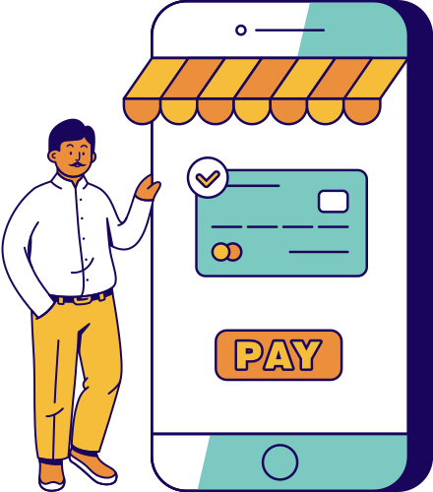


Connect
Easy
Presented by Team Incredibles

Slide 2






Hello everyone
We are Team Incredibles!

Slide 3

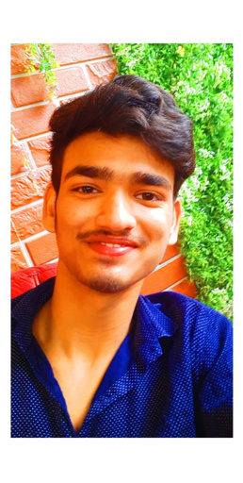


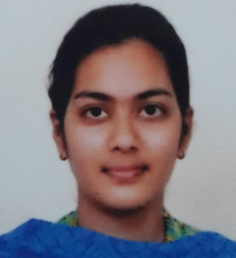

Meet the Group
HARSHIT
GUPTA
IFFAT
RIZVI
ISHITA BHARADWAJ
MS. SHIVANI
Backend
Developer
Frontend Developer
Content
Writer
Assistant Professor
Department of Computer Scienc

Slide 4

Abstract
Avoiding the production of waste is the most efficient strategy to reduce it. This project addresses a real-world issue that the kids are experiencing. Final-year students are anxious about their products because they are no longer helpful to them. Here, we offer a solution to their issue by establishing a connection between recently admitted students and college seniors. Avoiding scrapping of the items and assisting both seniors and juniors with this endeavour are the main goals. Additionally, the development of our website's chat system has allowed us to address the issue of interactions between majors and minors

Slide 5



1.) PROMOTING A SERVICE OR PRODUCT ONLINE
2.)SELLING A SERVICE OR PRODUCT
3.)PROVIDING PRODUCT SUPPORT.
4.)PROVIDE CORPORATE INFORMATION
5.)GOOGLE FORM TO INITIATE PROCESS IN SHORTER PERIOD OF TIME
6.)CHAT OPTION TO PROVIDE INTERACTION
Objective

Slide 6


Scope
After discussion with the team and with our guide, we can consider the scope of this project as follows:.
THIS MODEL SHALL BE USED TO UNDERSTAND THE PACE OF BUYING AND SELLING INSIDE THE HOSTEL. IT WOULD ALSO HELP TO IDENTIFY HOW INFLUENTIAL THE INTERACTION BETWEEN THE MAJORS AND THE MINORS IS. THIS WILL LEAD TO BETTER MONITORING CAPABILITY AND THEREBY IMPROVING THE QUALITY OF ONLINE E-COMMERCE SYSTEM INSIDE THE PREMISIS.
THE SENIORS AND JUNIORS WOULD BE ABLE TO INTERACT EASILY THROUGH THE CHAT SYSTEM OPTION WHERE THEY CAN DISCUSS ABOUT THEIR ENGINEERING DOMAINS. THIS WILL LEAD TO A BETTER UNDERSTANDING BETWEEN SENIORS AND JUNIORS..

Slide 7

Proposed
Methodolgy
CUSTOMER MODULE
Customer will be able to login to an account on our website and do seamless searching.
AUTHENTICATION
Authentication is the process of identifying users that request to a system, network, or device. Access control often determines user identity according to credentials like username and password. Other authentication technologies like biometrics and authentication apps are also used to authenticate user identity
SELLER MODULE
Different students would be able to create an account on our website and add the details of the products they are selling.

Slide 8
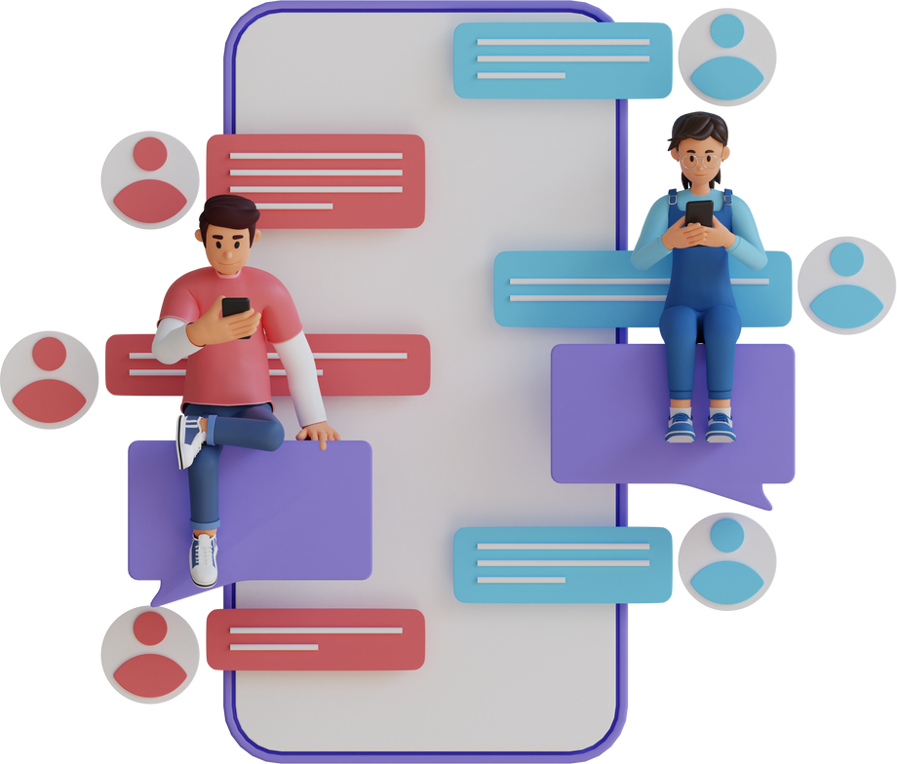
CHAT OPTION
The student can interact with seniors/juniors using search options in the respective development field
GOOGLE FORM
This feature will help the hosteler to register their complaints regarding hostel facility to be done in a shorter period of time

Slide 9

First page would be the login credentials page where the student can sign in by using their KIET library id ensuring that the students of KIET college can access the website only.
Explanation
After login successfully, the student can see the two options, either to add products in case of selling or can buy the products with the detailed descriptions .
Another feature we are providing for the hosteler is the google form where they can register their complaints regarding hostel facility.
The chat option will make the students to interact according to their respective domains and branches.

Slide 10





Technology Used

Slide 11






Conclusion
The student can easily add their used products in ConnectEasy website where the other students would be able to see for buying purpose with the detailed description
College hosteler student can register their complaints regarding hostel facility to be done in a shorter period of time
using Google Form
Student can easily connect with the senior students according to their respective development fields

Slide 12


Thank You!
DO YOU HAVE ANY QUESTIONS FOR US?

